Slide 1
ASC Violation Datasets

Slide 2
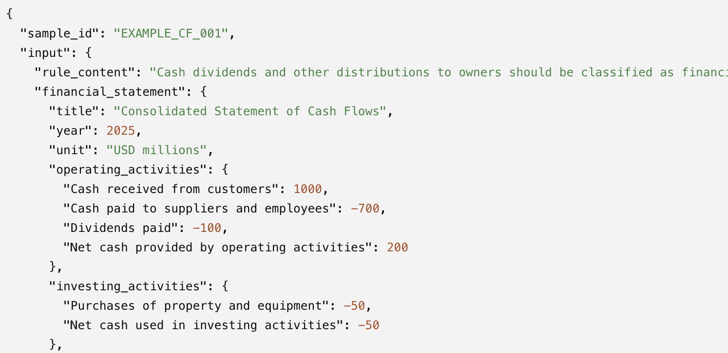
Synthetic Simple Task Accuracy
Synthetic Data Pruning: 10200 samples to 8800 samples (Some exact same sample corresponds to different violations, some rule violations are marked incorrectly.)
Number of Samples: 8800 Samples, 4400 positive, 4400 negative.
Inputs: ASC Rules Content + Inputs tables -> Violation exist or not?
Accuray: 85.69% (Deepseek), 86.10%(ChatGpt 5.5).
Precision: 86.17%
Recall: 83.34%
F1: 84.37%

Slide 3
Synthetic Medium Task Accuracy
Number of Samples: 4909 Samples, 4140 positive, 769 negative. (After Pruning)
Inputs: 8-10 ASC violation rule contents+Table Inputs -> identify which rule is violated or no rule violation exist.
Accuracy: 74.81% (Deepseek); 78.59% (ChatGpt*)
Macro-Precision: 77.15%
Macro-Recall: 76.60%
Macro-F1: 75.28%
Weighted-F1: 78.51%
Table Type | # of Samples | Correct Samples | Accuracy
Balance Sheet | 1410 | 1192 | 84.56%
Cash Flow Statement | 1372 | 1102 | 80.30%
Income Statement | 1301 | 924 | 70.99%
Statement of Equity | 826 | 640 | 77.44%
Overall | 4909 | 3858 | 78.59%

Slide 4
Most Frequent ASC violations
Rule ID | Incorrect/Total | Incorrect Percent | Reason
ASC 220-10-45-1 | 42/56 | 75% | Most samples are classified as non-violation
ASC 360-10-35-4 | 28/54 | 51.85% | Most samples are classified as non-violation
ASC 220-10-45-14 | 22/55 | 40.00% | Many samples are classified as violations of rule ASC 360-10-45-14

